Slide 1


Corona
Data Analysis
Probabilistic Modeling and Reasoning
01

Slide 2


Objective of the Study:
To explore and analyze COVID-19 data using Exploratory Data Analysis (EDA) techniques.
To identify trends, patterns, and key factors impacting the survival rates of COVID-19 patients.
To estimate the probability of survival based on various demographic and clinical factors (age, pre-existing conditions, geographic region, etc.).
To provide actionable insights that could help in resource allocation and policy-making during a pandemic response.
Objective
02

Slide 3
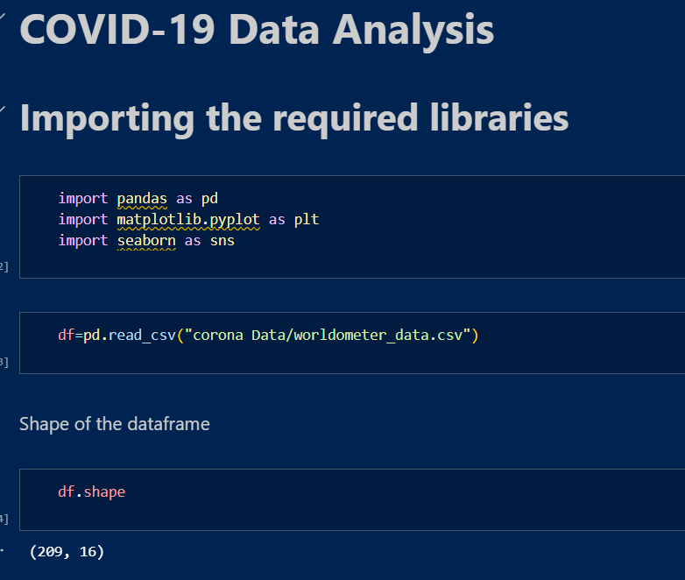

Library used
Pandas - Data Manipulation and Analysis
Matplotlib - Data Visualization
Seaborn - Statistical Data Visualization
03

Slide 4
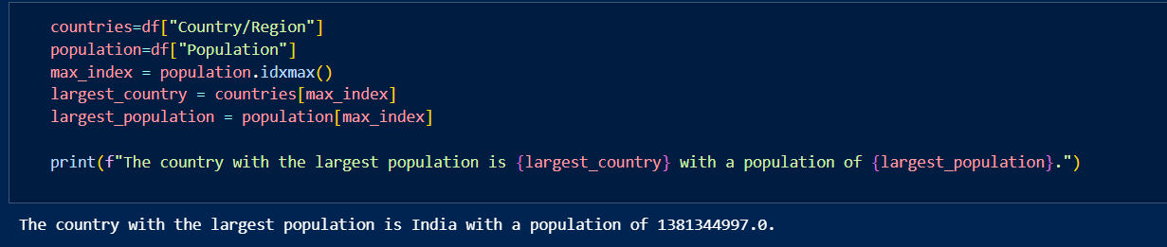
1. Per Capita Analysis
Relative Comparisons: Simply looking at the raw number of cases or deaths doesn’t give a true picture of how severely a country is affected. A country with a large population will naturally have more cases than a small one. To make meaningful comparisons, metrics like "cases per million" or "deaths per 100,000 people" are used.
Understanding Severity: Per capita metrics allow for a clearer understanding of how widespread the virus is within a population, regardless of the country's size. A small country with a relatively high number of cases per capita could be struggling more than a large country with higher total numbers.
Population
04

Slide 5
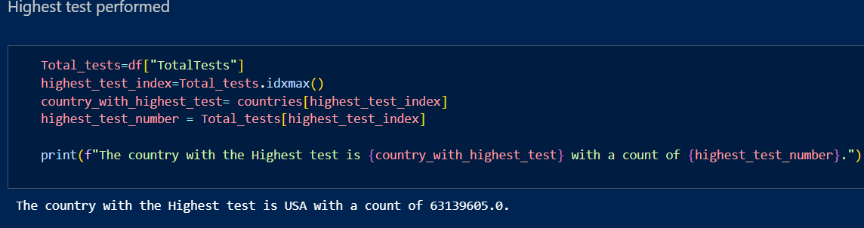
Test Performed
Understanding Spread: The number of tests performed helps in understanding the extent of virus spread. If a country performs widespread testing, it can detect more cases, including asymptomatic and mild cases that otherwise might go unreported.
Undercounting Risks: In countries with limited testing, the true number of COVID-19 cases may be significantly undercounted, which can give a false sense of security. Fewer tests might only detect the most severe cases, hiding the actual scale of the outbreak.
05

Slide 6
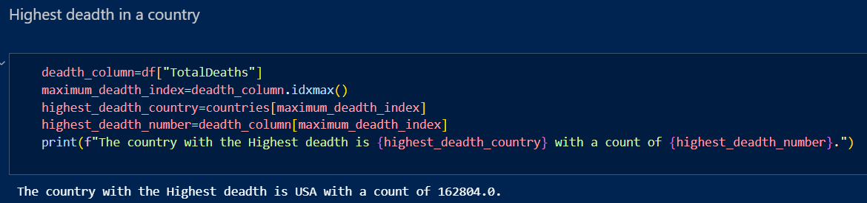
Total
Deadth
Factors Influencing High Death Rates:
Healthcare Capacity: Overwhelmed healthcare systems led to higher death rates.
Vaccine Rollout: Slower or unequal vaccine distribution contributed to more deaths.
Age Demographics: Older populations saw higher death rates.
Variants: Deadly variants like Delta increased mortality.
Economic and Social Factors: Poverty and limited access to healthcare exacerbated death rates in some regions.
06

Slide 7
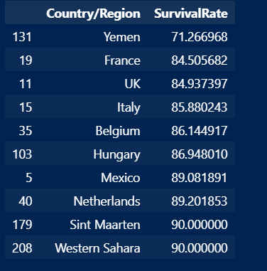
Survival Rate according the the Total cases observed
Calculate Survival Rate:
The survival rate for each country is calculated based on the number of deaths relative to the total number of confirmed cases.
Sort Countries by Survival Rate:
The countries are sorted in ascending order by their survival rate, meaning countries with the lowest survival rates (highest mortality rates) are listed first.
07

Slide 8
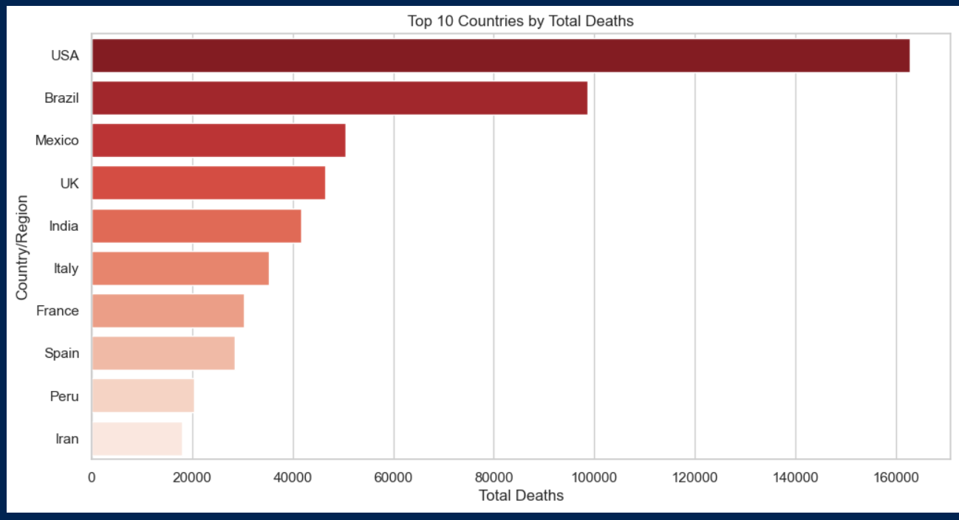
Total Deadth
Top 10 Countries
08

Slide 9
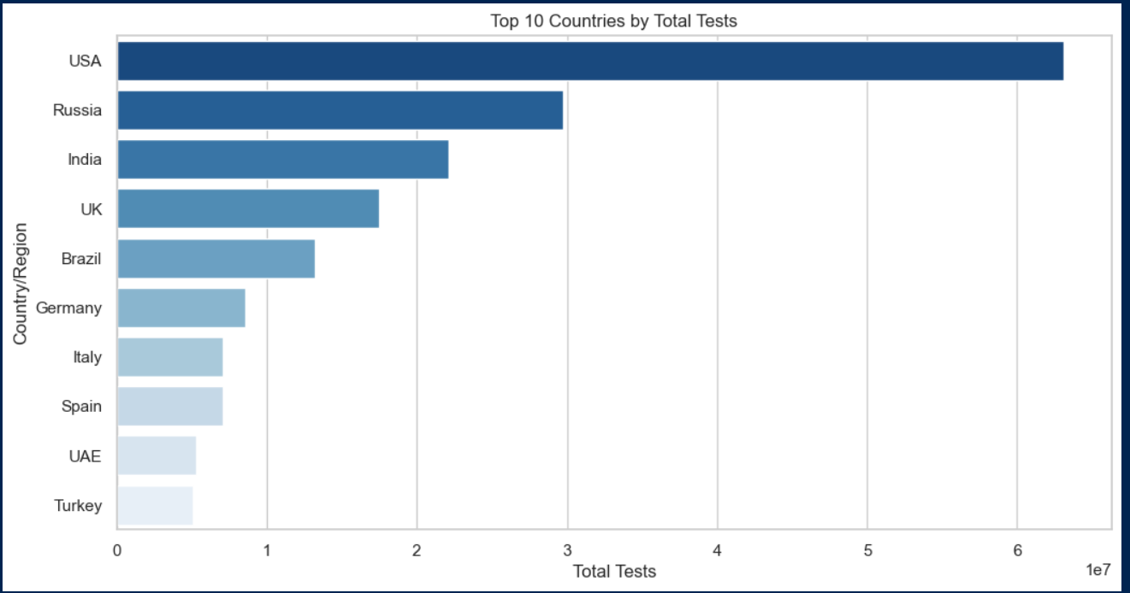
Total Tests
Top 10 Countries
09

Slide 10
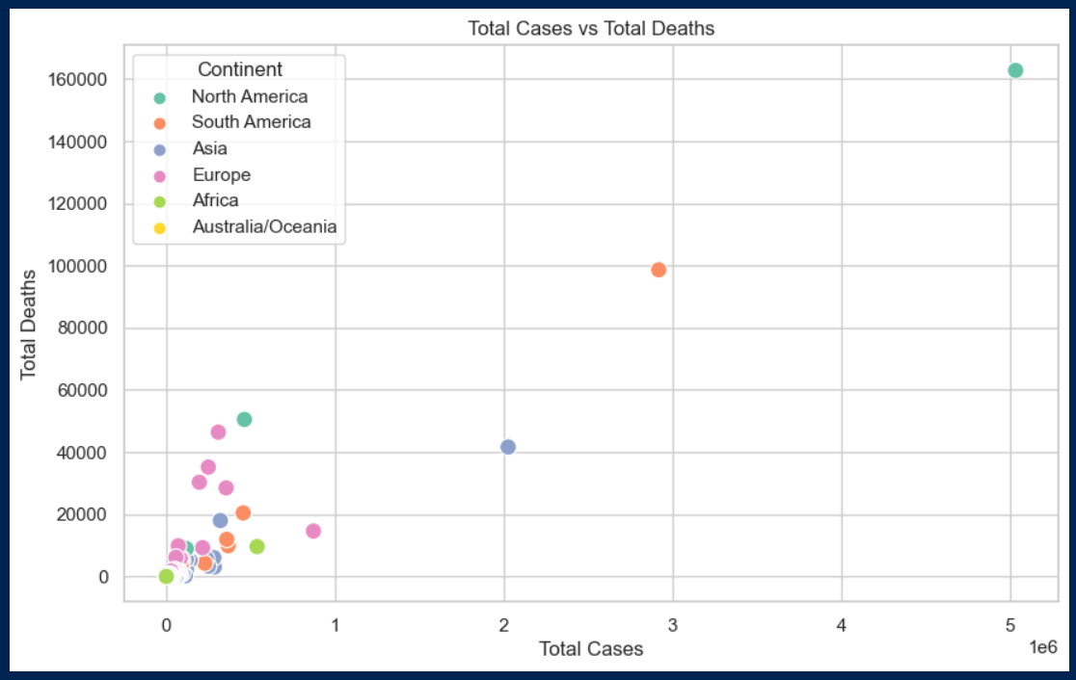
Total Cases Vs Total Deadth
Continents
08

Slide 11
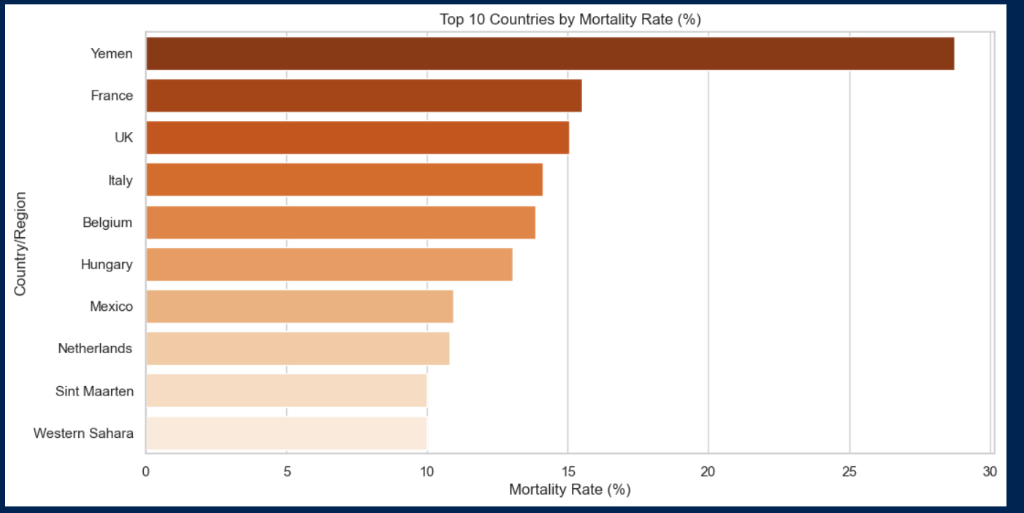
Mortality Rate
Top 10 Countries
08

Slide 12
Thank
You
https://github.com/Sameershrinath/CoronaDataAnalysis.git
Submitted By:
Samir Srinath
10

